Slide 1

INTRODUCTION TO
By:
Ms. Chinty Chhawari
ICT Consultant
CIET, NCERT
Source: http://www.algodoo.com/

Slide 2

What is ALGODOO ?
Physics-based 2D sandbox freeware.
Great tool for learners to enjoy visual representations of physics in motion.
Simple drawing tools to design, construct and explore the world of physics.
Source: http://www.algodoo.com/
Notes:
Freeware is any copyrighted software, application or program that may be freely downloaded, installed, used and shared.
A box that contains sand for children to play in. : a place, area, or environment that provides opportunities for variation and experimentation in a way suggestive of children playing in a sandbox.

Slide 3
Algodoo
Animation Tool
Simulation Tool
Engineering Tool
Gaming Tool
Source: http://www.algodoo.com/

Slide 4
Features of Algodoo
Free to use and user friendly design interface.
Exploration of Algodoo tools makes learning fun.
Practical enactment of concepts of physics.
Simulation of fundamental physical science concepts.
Enhances the conceptual knowledge of learner.
Analysis and results of simulations in graphical output.
Explanation of concepts of physics for academic purpose.
Source: http://www.algodoo.com/

Slide 5
Technology
Algodoo is based on the latest technologies, from Algoryx Simulation AB, for interactive multiphysics simulation.
Algodoo runs on Windows and Mac OS.
Algodoo is optimized for the Intel® powered convertible Classmate PC and interactive whiteboard systems like SMART Board.
Source: http://www.algodoo.com/

Slide 6
PROPRIETARY RIGHTS
Do not modify, rent, lease, loan, sell, distribute or create derivative works based on the Service or the Software, in whole or in part.
A personal non-transferable non-exclusive right and license to use the object code of its Software on a single computer.
Do not copy, modify, create a derivative work of, reverse engineer or attempt to discover any source code, sell, assign, sublicense, grant a security interest in the Software.
Do not modify the Software in any manner or form.
Do not reproduce, duplicate, copy, sell, resell or exploit for any commercial purposes.
Source: http://www.algodoo.com/

Slide 7


Let’s learn it!!!!!
Visit to http://www.algodoo.com/
Source: http://www.algodoo.com/

Slide 8

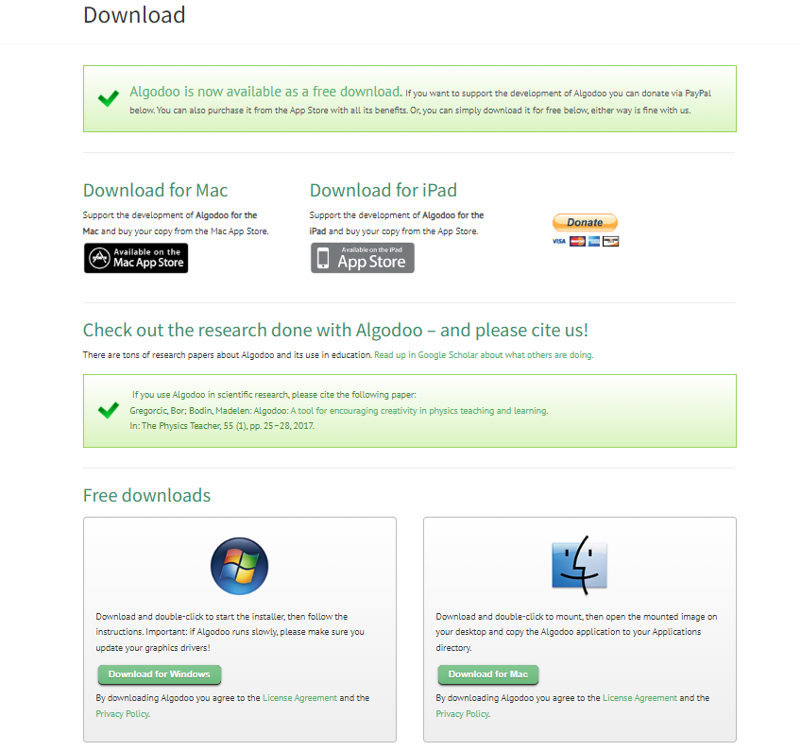
How to download Algodoo?
Source: http://www.algodoo.com/

Slide 9
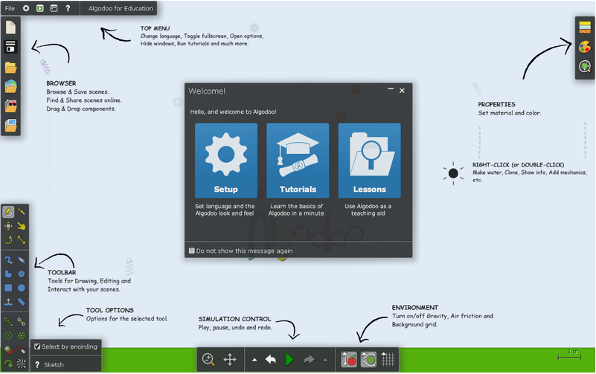
Home screen
Source: http://www.algodoo.com/

Slide 10
Source: http://www.algodoo.com/

Slide 11
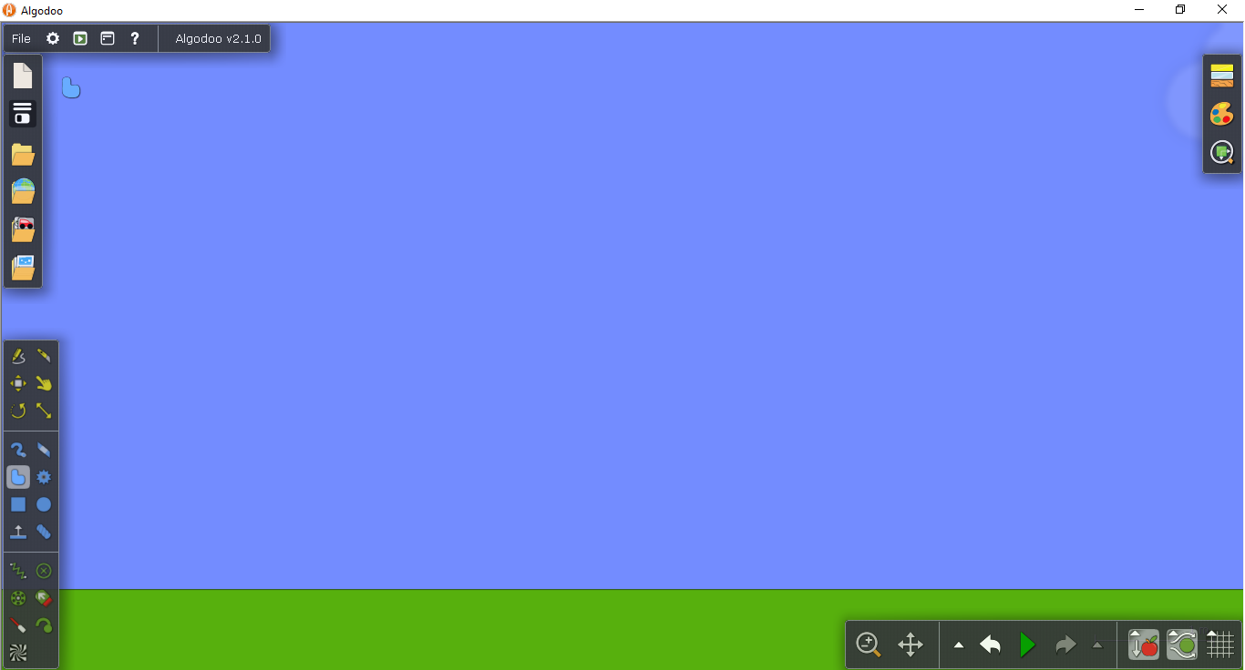

Sketch
Knife
Move
Drag
Rotate
Scale
Brush
Eraser
Polygon
Gear
Box
Circle
Chain
Plane
Fixate
Spring
Axle
Thruster
Laser Pen
Tracer
Texture
Toolbar
Source: http://www.algodoo.com/

Slide 12
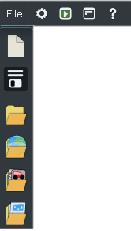
Browser and Top Menu
Toggle Play Mode
Options
Menu
File
Help
New Scene
Save and Share
My Scenes
Algobox
Components
Lessons
Source: http://www.algodoo.com/

Slide 13

PROPERTIES
Material
Appearance
Visualization
Source: http://www.algodoo.com/

Slide 14

List of Undoing
List of Redoing
Zoom
Simulation
Friction or Buoyancy
Pan
Redo
Grid
Undo
Gravity
Simulation Control & Environment
Source: http://www.algodoo.com/

Slide 15
Drawing Tool
Sketch
Box
Circle
Brush
Polygon
Chain
Plane
Source: http://www.algodoo.com/

Slide 16
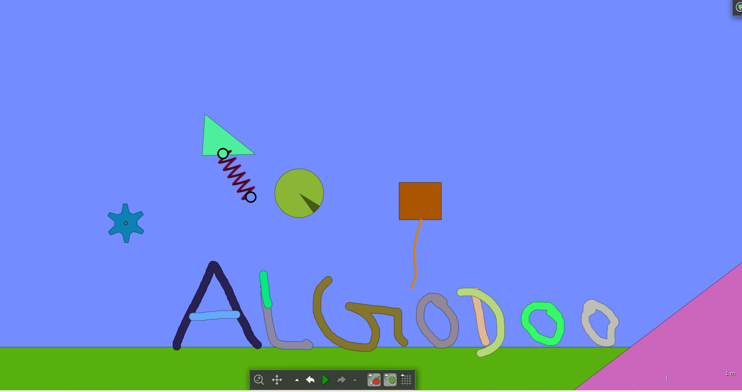
Source: http://www.algodoo.com/

Slide 17
Resizing and Editing Tools
Editing Tools
Move
Knife
Rotate
Clone
Scale
Source: http://www.algodoo.com/

Slide 18
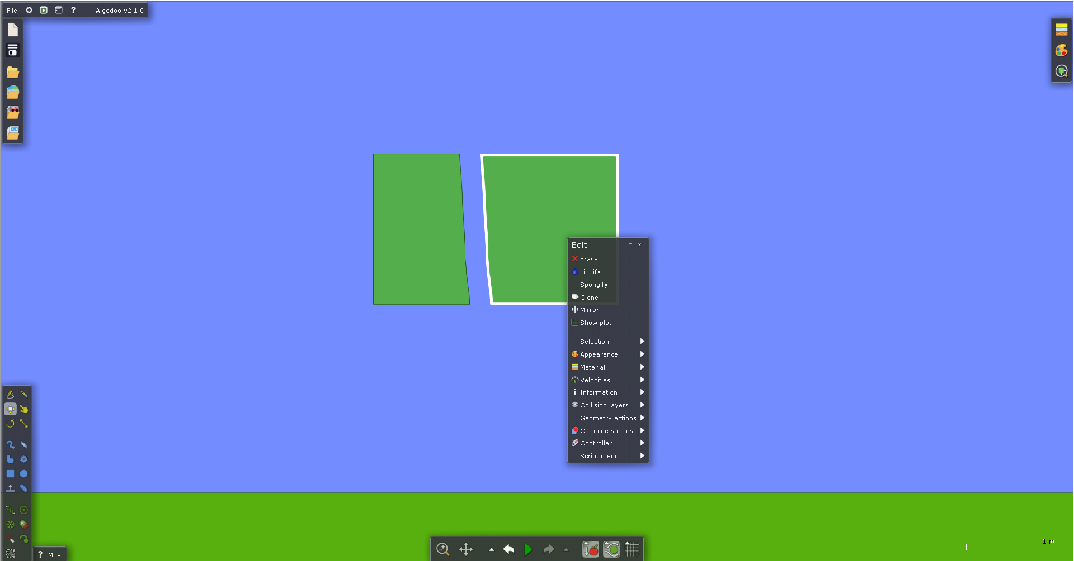
Editing Tool
Source: http://www.algodoo.com/

Slide 19
Tools for Physics Simulation
Physics Tools
Laser Pen
Spring
Axle
Thruster
Gravity
Friction
Fixate
Source: http://www.algodoo.com/

Slide 20
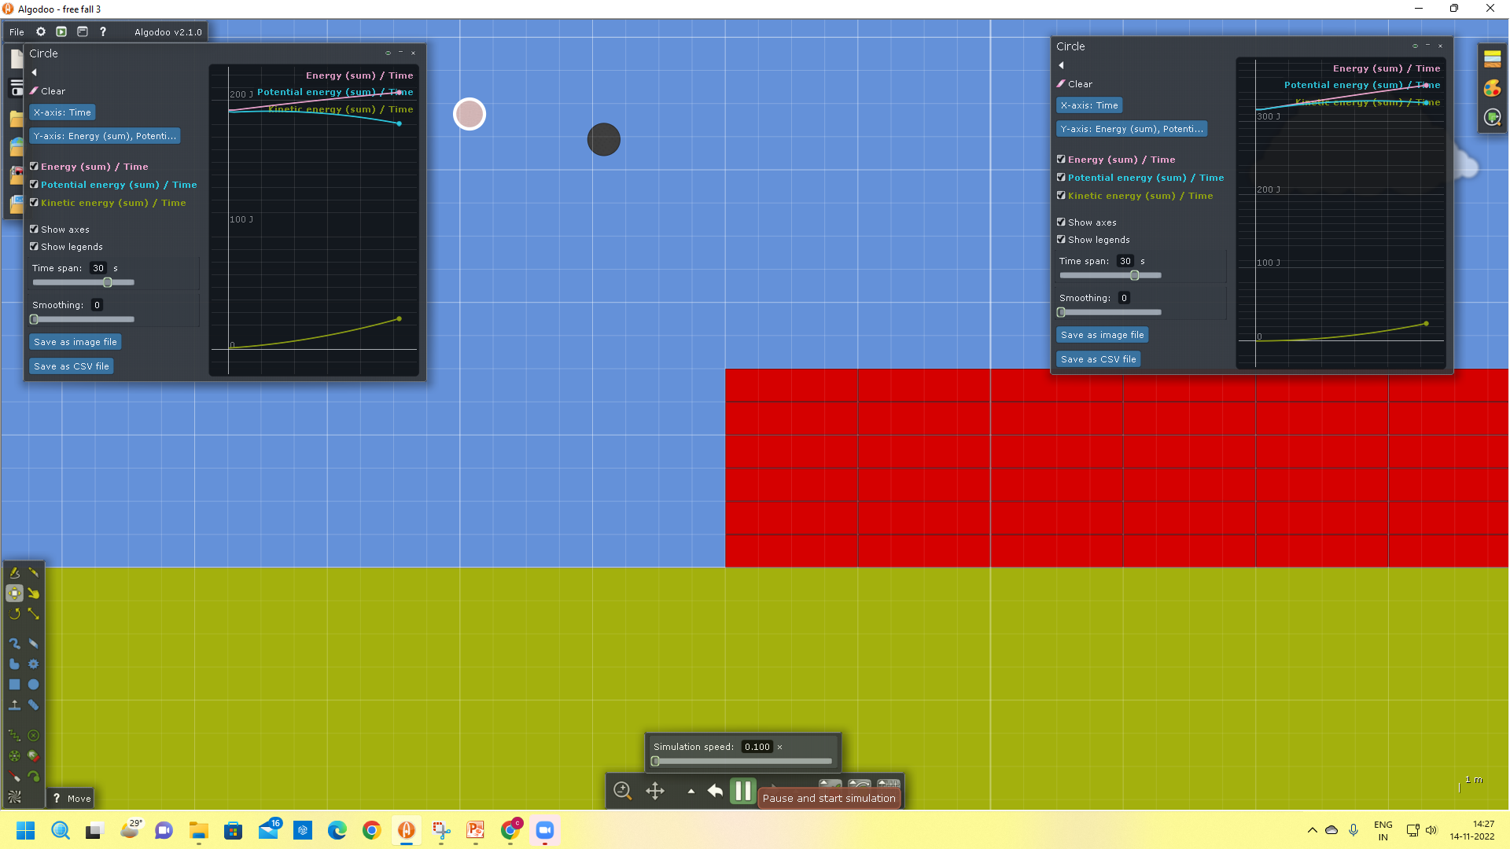
Falling Object from the same height
Source: http://www.algodoo.com/

Slide 21
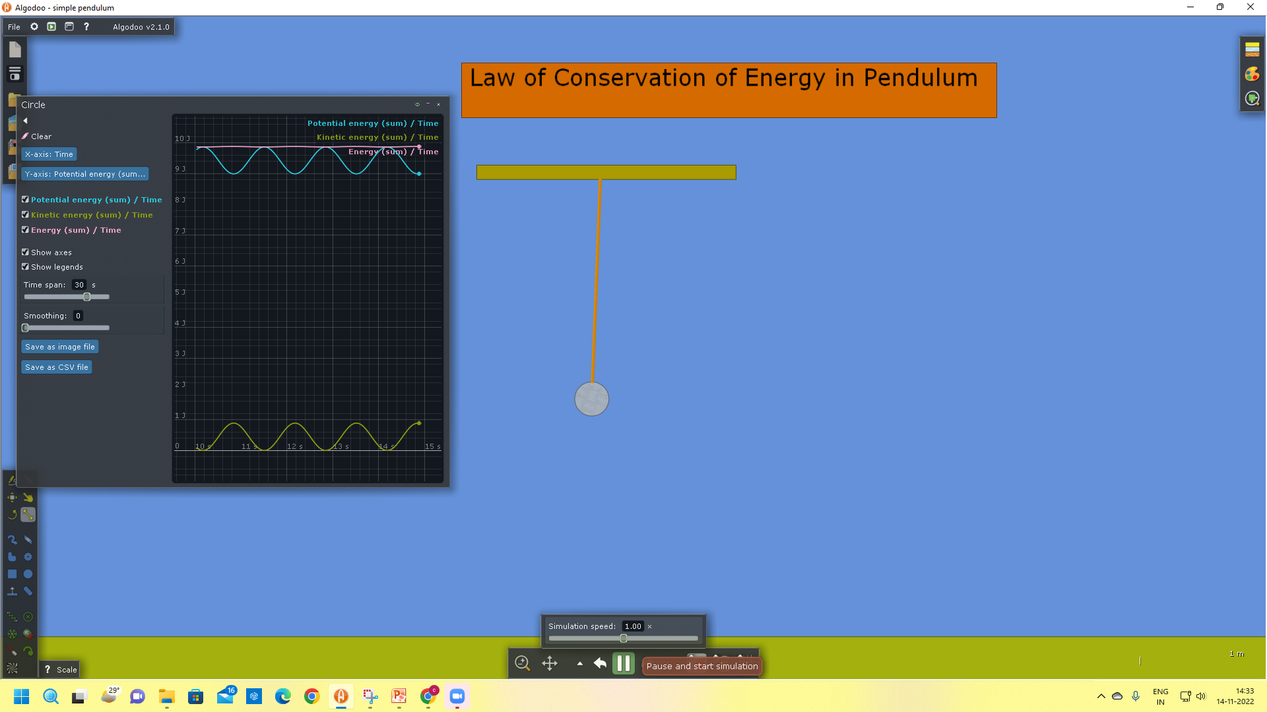
Law of Conservation of Energy
Source: http://www.algodoo.com/

Slide 22
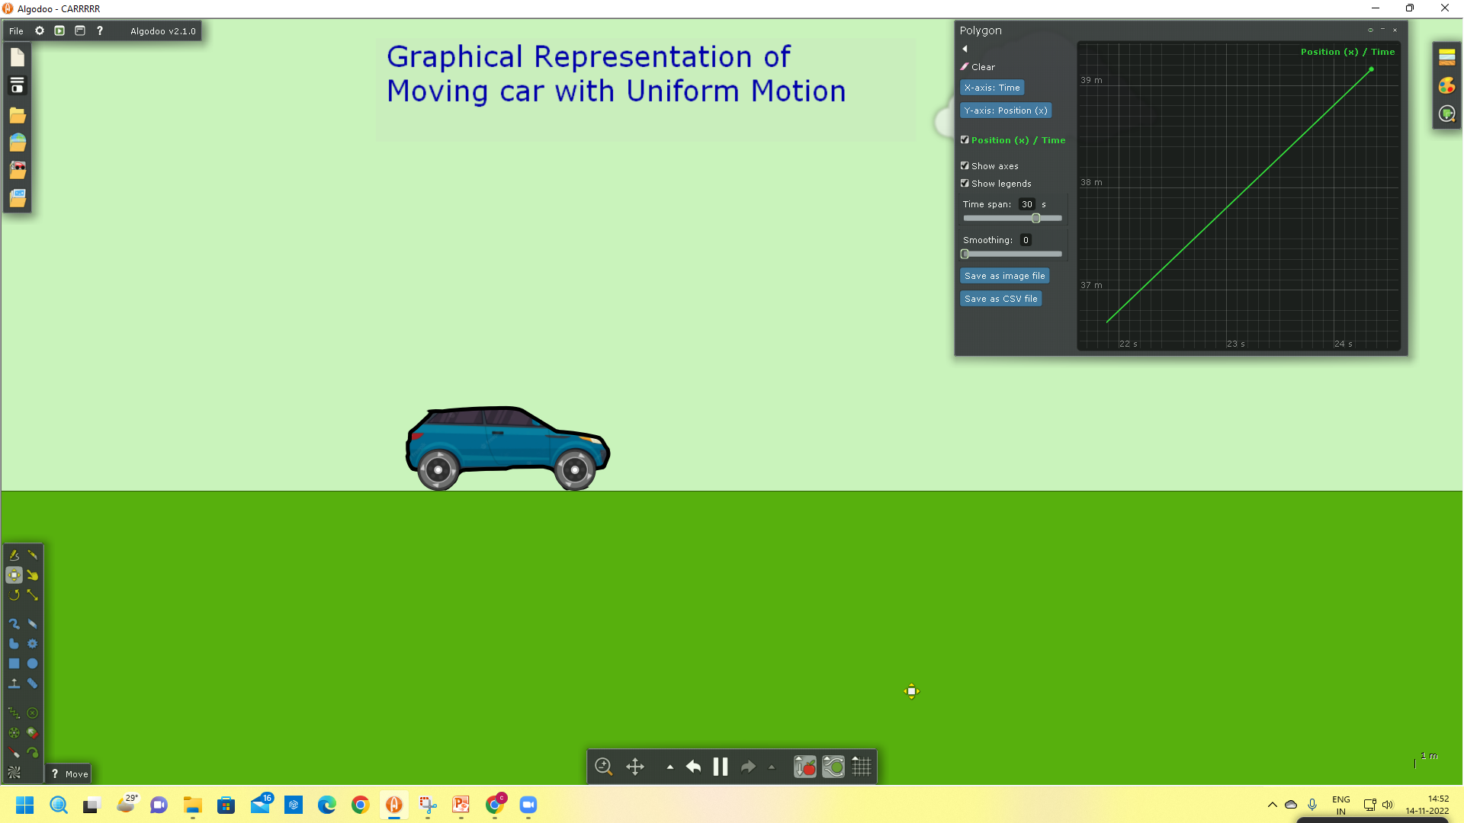
Uniform Motion
Source: http://www.algodoo.com/

Slide 23
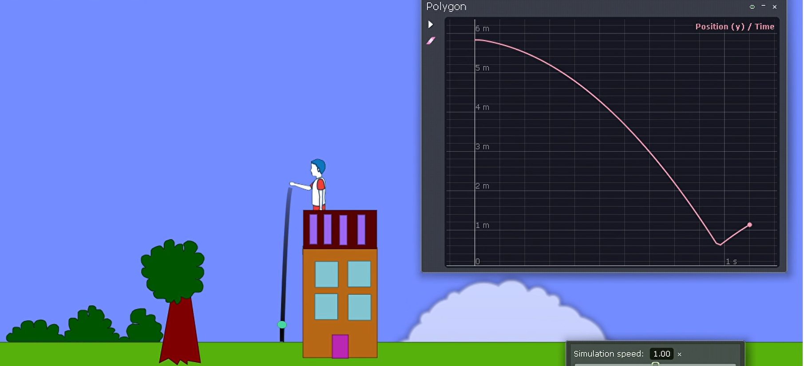
Free Fall
Source: http://www.algodoo.com/

Slide 24
Creativity
is
Magical………..
Keep Exploring Algodoo!!!

Slide 25
Enjoy Algodoo..…..
http://www.algodoo.com/

